Slide 1
gMG Crisis Prediction and Disease Assessment through voice AI on a wearable device
Javier Díez Pérez

Slide 2
Introduction
Overview of Myasthenia Gravis (MG) as a chronic autoimmune disorder
Importance of personalized monitoring for myasthenic crises
Challenges in current symptom assessment

Slide 3
Challenges in Diagnosing Myasthenic Crises
Limitations of existing MG assessment scales (MG-ADL, QMG)
Difficulties in predicting imminent crises

Slide 4
Potential of Voice AI
Role of voice synthesis in detecting muscular and respiratory function
Comparison of traditional vs. AI-enhanced diagnostic methods

Slide 5
Technological Approach
Description of Google’s Health Acoustics Representations (HeAR)
Integration of AI models with wearable devices

Slide 6
Objective
Goal to develop non-invasive AI tools for early crisis detection
Integration of edge AI models into wearable technology

Slide 7
Methodology
Data collection and collaborations
Machine learning algorithms and model development
Device specifications

Slide 8
Technological Innovation
AI-based precision diagnostics in neurology
Comparisons to AI applications in other medical fields

Slide 9
Expected Impact
Improved diagnostic accuracy and patient outcomes
Cost reduction and increased accessibility

Slide 10
Implementation plan
Phases of development: Research, testing, commercialization
Target markets and initial rollout strategy

Slide 11
Conclusion
Summary of the proposed solution's impact on healthcare
Vision for broader applications in other medical areas

Slide 12
Common symptoms in similar indications
Disorder | Muscle | Voice | Respiratory
gMG | Muscle weakness | Hoarness, etc … | Dyspnoea, respiratory failure
NF1 | Muscle weakness | * | Breathing problems *
HPP | Muscle stiffness, weakness and pain | Secondary to neurological symptoms ** | Breathing difficulties and respiratory failure
Amyloidosis | Muscle weakness | Hoarness | Dyspnoea, secondary difficulties (cardiac) ***
Others? Ex: Mitochondrial, etc … | Muscle weakness | Muscle weakness

Slide 13
Companies / Startups
Company | Web | Description
Canary Speech | https://canaryspeech.com | Canary Speech’s vocal biomarker technology unlocks voice as a vital sign, leading a new era of machine learning in healthcare.
VoiceMed | https://www.voicemed.io/ | Acoustic analysis of voice and breath to measure multiple innovative biomarkers—for lung health, fitness, and more. Powered by advanced AI and deep-tech innovation.
ModalityAI | https://modality.ai/ | Modality.AI, Inc. has developed the first automated, clinically validated, multimodal system to assess neurological and psychiatric states, in clinic and remotely.
Vocadian | https://www.vocadian.ai/ | Empowering safer, smarter workplaces, we deliver a cutting-edge voice-based tool that assesses and predicts fatigue in real-time
UHURA BIONICS | https://www.uhura.pl/en | Uhura Bionics has set itself the goal of finding solution for atypical speech in voice and speech disorders for more than 136 million people worldwide.
Noah Labs | https://www.noah-labs.com/ | At Noah Labs, we empower patients with cardiovascular conditions to live healthier, longer lives by developing voice-based biomarkers for early detection and enabling the most accessible remote monitoring.
Kintsugi | https://www.kintsugihealth.com/ | We train and validate our voice biomarker AI models by conducting clinical trials with prestigious academic institutions and collaborating with top experts and research partners in healthcare.

Slide 14
Companies / Startups
Company | Web | Description
Amplifier | https://www.amplifierhealth.com | Like heart rate or blood pressure, your voice holds crucial health data. Amplifier unlocks this data, turning voice into a vital sign.
Audeering | https://www.audeering.com/ | Our cutting-edge Voice AI technology enables machines to understand and respond to human vocal expression, ushering in a new age of empathetic AI-interactions. audEERING® bridges the gap between humans and machines, creating a future where technology is in tune with our tone of voice.
Klaatch | https://www.klaatch.com/ | Klaatch has developed the Social Quotient, the first holistic measure of individual and community social connection that finally provides the information you need to increase social connection, reduce loneliness, and improve performance.
Phonely | https://www.phonely.ai/product | Everything you need to answer any call with AI Phonely gives you all the tools you need to harness voice AI, empowering you to reduce costs and scale your contact center effortlessly.
Virtuosis | https://www.virtuosis.ai/ | Track mood and engagement, prevent burnout, and early-detect team conflicts. Identify individual needs and automatically recommend the best support.
Sonde | https://www.sondehealth.com/ | Sonde’s API/SDK platform makes it easy to integrate vocal biomarker analysis into your organization’s health initiatives to gain new insights into users’ mental, cognitive and/or respiratory fitness.
Sonaphi | https://sonaphi.com/ | Sonaphi is a machine learning analysis solution that generates health assessments from a 30-second smartphone voice recording. Results are fast, affordable, & easy. From general wellness insights to specific health conditions including.

Slide 15
Consortiums
Name | Web | Description
Bridge2AI Voice | https://b2ai-voice.org/ | The Bridge2AI Voice Consortium aims to integrate the use of voice as biomarker of health in clinical care to assist in screening, diagnosis, and treatment of a broad range of diseases. Read on to learn more about this project.
Colive Voice | https://www.colivevoice.org/en/ | Colive Voice is a groundbreaking digital health study aiming to identify vocal biomarkers to improve diagnosis and monitoring of symptoms and diseases.

Slide 16
Advantages of voice biomarkers
Voice and speech, by their very nature, encapsulate a lot of health-related information, such as, but not restricted to our emotional state, cognitive function, respiratory health, or neuromuscular changes.
Voice and speech data remain a largely underutilized resource in clinical research, mostly due to the lack of standards and processes to integrate voice biomarkers into clinical trials.
Voice data can be collected non-invasively and regularly, providing a dynamic picture of an individual’s health over time.
This aspect is especially critical in the context of chronic diseases, where patients might find frequent clinical visits to be a substantial burden.
The low-cost implications of integrating voice data into clinical trials are noteworthy.

Slide 17
Challenges of voice biomarkers
Lack of standardized protocols for voice data collection and analysis.
Many voice features are not specific to a single disease or symptom. This non-specificity, while challenging, also underscores the potential of voice as a holistic biomarker for health.
Voice biomarkers can also become very precisely measurable digital endpoints in the context of clinical trials.
Collecting the data now in a standardized fashion can provide an important advantage that can later be explored.
Ensuring the privacy and security by design of voice data is of paramount importance to ensure the buy-in from end users (patients, healthcare professionals) and stakeholders. (i.e., HIPAA, GDPR, AI Act)

Slide 18
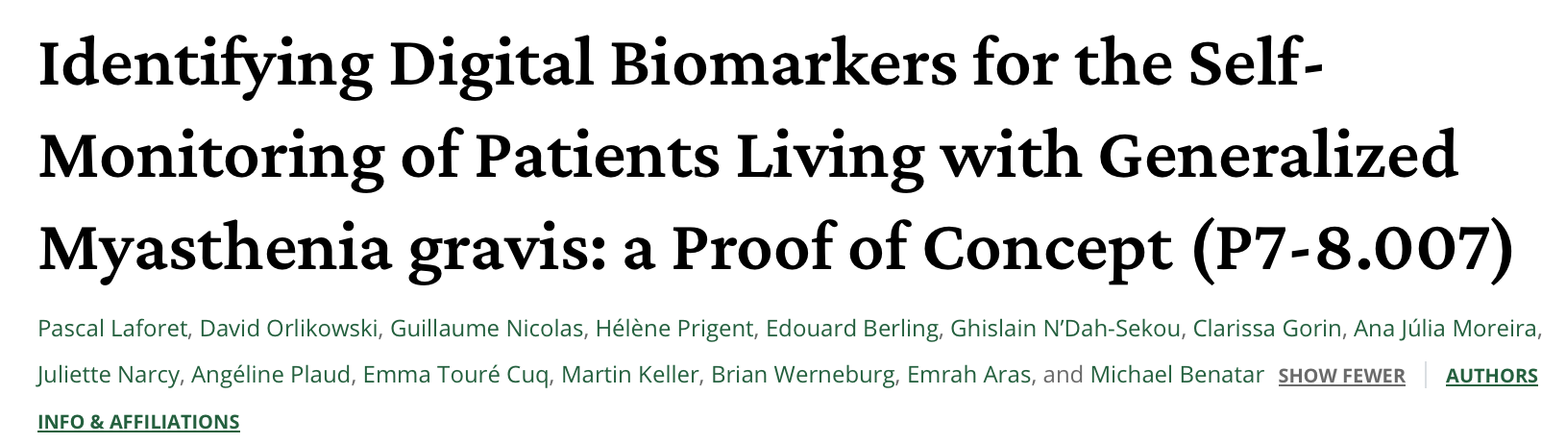
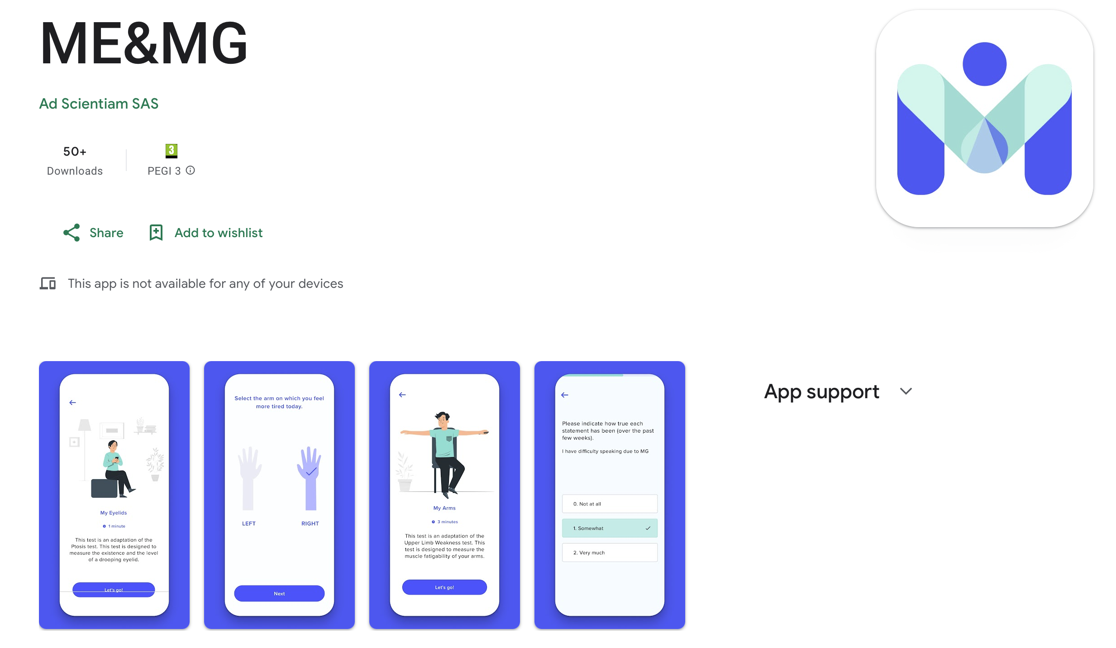
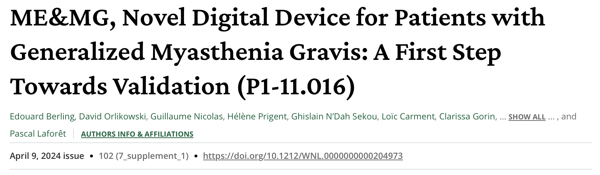
“We perceived a need for an unsupervised patient self-assessment digital solution to monitor symptomatology outside office visits. In 2023, development of ME&MG, a smartphone solution, will begin. It aims to inform and improve communication between patients and their care teams. International multicenter studies comparing ME&MG to clinical gold standards including the Quantitative Myasthenia Gravis score, will be deployed.”

Slide 19
Clinical Trials on Medical Devices for gMG
The ME&MG Digital Solution for Autonomous Assessment of Myasthenia Gravis
ClinicalTrials.gov ID NCT05564936
Sponsor Ad scientiam
Information provided by Ad scientiam (Responsible Party)
Last Update Posted 2025-04-11
Summary: ME&MG is a standalone software (digital solution) running on patients smartphones, connected to a web portal for physicians. It is intended to be used as an unsupervised digital self-assessment tool for the monitoring of disabilities in patients living with MG. ME&MG contains digital active tests for the assessment of ptosis, breathing, dysarthria, upper- and lower-limb (arms and legs) weakness, treatment follow-up, and validated e-questionnaires related to daily activities, pain, fatigue, sleep, and depression disorders. The objectives of this study are to validate the accuracy, reliability and reproducibility of the unsupervised at-home self-assessment of symptoms on the patient's smartphone with ME&MG versus the standard in-clinic testing, as well as to evaluate the safety of the solution, its usability and satisfaction.

Slide 20
Brief Summary
ME&MG is a standalone software (digital solution) running on patients smartphones, connected to a web portal for physicians. It is intended to be used as an unsupervised digital self-assessment tool for the monitoring of disabilities in patients living with MG.
ME&MG contains digital active tests for the assessment of ptosis, breathing, dysarthria, upper- and lower-limb (arms and legs) weakness, treatment follow-up, and validated e-questionnaires related to daily activities, pain, fatigue, sleep, and depression disorders.
The objectives of this study are to validate the accuracy, reliability and reproducibility of the unsupervised at-home self-assessment of symptoms on the patient's smartphone with ME&MG versus the standard in-clinic testing, as well as to evaluate the safety of the solution, its usability and satisfaction.

Slide 21
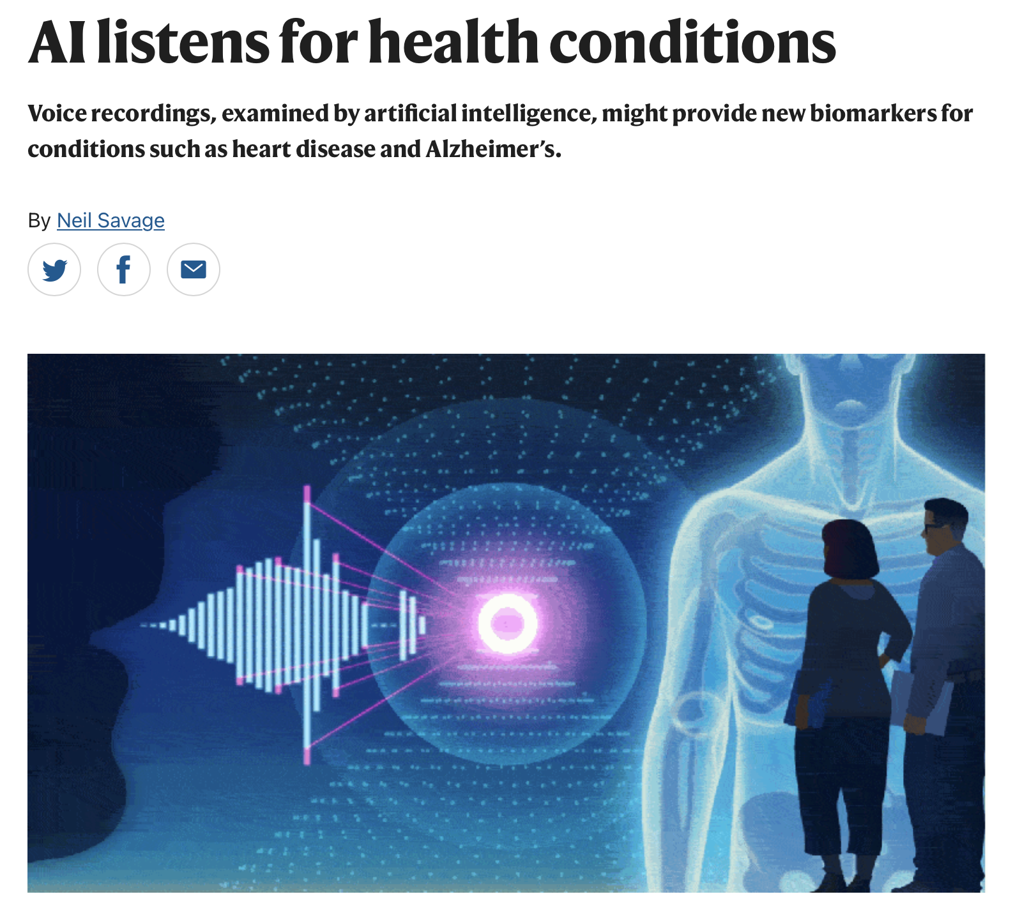
AI listens for health conditions Voice recordings, examined by artificial intelligence, might provide new biomarkers for conditions such as heart disease and Alzheimer’s.

Slide 22

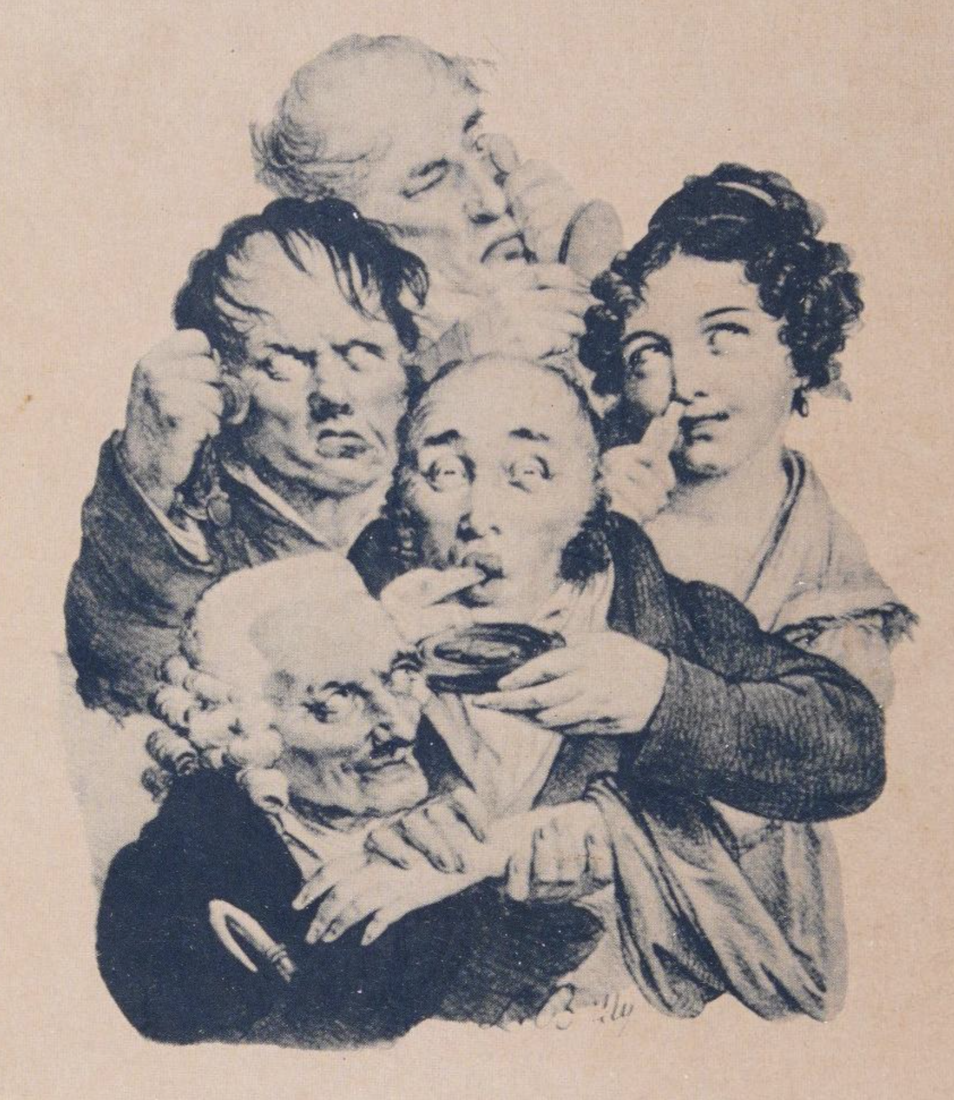
Medicine and the five senses From the days of Hippocratic 'bedside medicine' to the advent of the CAT scanner, doctors have always relied on their senses in diagnosing and treating disease. Medical education, from the apprenticeship, to the rise of the laboratory, has sought to train the senses of students who must act like medical detectives. At the same time, debate since antiquity has pondered the hierarchy of the senses - from noble vision to baser touch and smell.

Slide 23
Many thanks

